Slide 1

UNIVERSITY INSTITUTE OF SCIENCES
Academic Unit V
Bachelor of Engineering
(Computer Science & Engineering)
Biology For Engineers
23SZT148
Recombinant DNA Technology
DISCOVER . LEARN . EMPOWER

Slide 2
Recombinant DNA Technology
Stem Cell Biology
Tissue Engineering

Slide 3
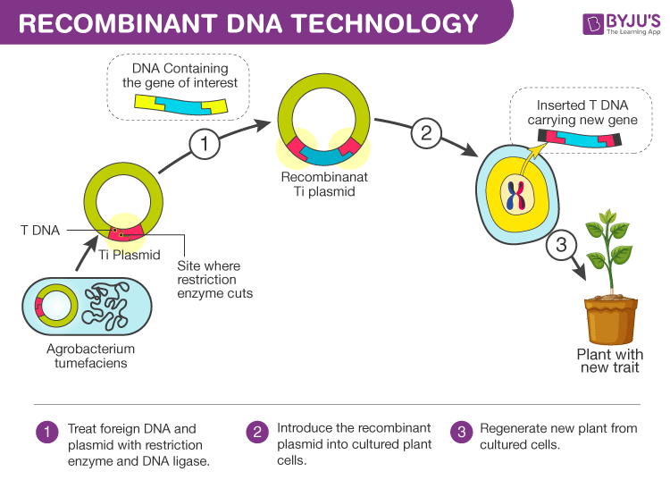

Course Outcome
CO Number | Title | Level
CO1 | Identify the biological concepts from an engineering perspective. | Remember
CO2 | Development of artificial systems mimicking human action. | Understand
CO3 | Explain the basic of genetics that helps to identify and formulate problems | Understand
CO4 | Apply knowledge of measurement system, biomedical recording system and biosensors to excel in areas such as entrepreneurship, medicine, government, and education. | Understand
CO5 | Integrate biological principles for developing next generation technologies | Understand
Will be covered in this lecture
https://byjus.com/biology/tools-recombinant-dna-technology/

Slide 4
SYLLABUS
Unit-3 | Bio Medical Instrumentation | Contact Hours: 15
Chapter 1 Electrical stimulus and biophysical activity Chapter 2 Biomedical recording system Chapter 3 Tissue Engineering | Electrical stimulus and biophysical activity: Patient, electrical shock and hazards, leakage current, Electrical activity of heart (ECG), Electrical activity of brain (EEG), Electrorentinogram (ERG), Electro-occologram (EOG), Electromyogram (EMG). Biomedical recording systems: Basic Recording system, General consideration for signal conditioners Preamplifiers, Differential Amplifier, Isolation Amplifier, Vectorcardiograph, Phonocardiograph, Other biomedical records, Patient isolation, and accident prevention. Tissue Engineering: Recombinant DNA technology, Stem cell biology & Tissue Engineering.

Slide 5
Recombinant DNA Technology
Production of unique DNA molecule by joining together two or more DNA fragments (not normally associated with each other).
DNA fragments are usually derived from different biological sources.
The recombined DNA molecule is inserted into a host organism to produce new genetic combinations that are of value to science, medicine, agriculture, and industry.

Slide 6
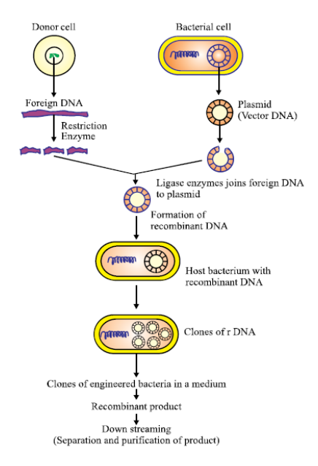
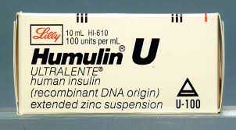
Recombinant DNA technology is the joining together of DNA molecules from two different species.
Recombinant DNA Technology- Steps>>>>>>>>>
Using Recombinant DNA technology, we can isolate and clone single copy of a gene into an indefinite number of copies, all identical.
e.g. Bacterial DNA + human gene for insulin (INS gene- short arm of 11 ch)
These new combinations of genetic material or Recombinant DNA (rDNA) molecules are introduced into the host cells, where they propagate and multiply.

Slide 8
Tools used in Recombinant DNA technology
Vector: A vehicle to transfer rDNA into the cells
Restriction enzyme: Scissors to cut DNA
The vectors help in carrying and integrating the desired gene.
DNA Ligase: Help to join DNA
These form a very important vehicles that carry forward the desired gene into the host organism.
Plasmids and bacteriophages are the most common vectors in recombinant DNA technology.
Restriction enzymes cut DNA molecules at specific DNA sequences called restriction sites
DNA ligase is an enzyme that seals the bonds between DNA fragments

Slide 9
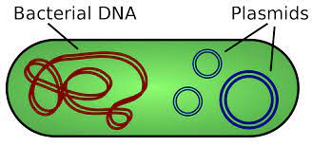
Plasmids
Plasmids are small circular double-stranded DNA molecules that replicate independently of the chromosomal DNA.
Plasmids can be transferred from one bacterium to another.
e.g. pUC18, pBR322
A vector, is a DNA molecule (often plasmid or virus) that is used as a vehicle to carry a particular DNA segment into a host cell.
Commonly used vectors- plasmids (circular DNA molecules that originated from bacteria), viruses, and yeast cells.

Slide 10
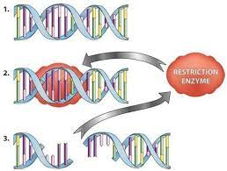
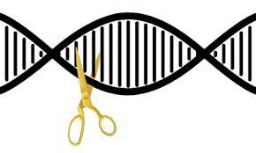
Restriction Enzymes
A restriction enzyme cleaves DNA sequences at sequence-specific sites, producing DNA fragments with a known sequence at each end.
Each restriction enzyme: Recognizes a specific base sequence in double-stranded DNA
Splits the DNA at this site called the restriction site yielding restriction fragments.
They are named after the bacterium in which they are found e.g. Hind I, Eco RI
These enzymes serve as molecular scissors to cut DNA into defined fragments

Slide 11
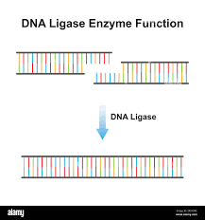
DNA Ligase
DNA ligases are the enzymes that are used to join (ligate) DNA fragments
The DNA ligase joins two DNA strands by forming a phosphodiester bond between them.
It is known as a molecular glue.
It is used to join genes of interest with the cloning vector.
e.g. T4 DNA ligase is used in rDNA technology.

Slide 12
Host organism
The organism in which the gene of interest (with or without vector) is inserted and multiplied is known as the host organism.
Escherichia coli is commonly used for multiplication of various genes.

Slide 13
Steps/stages for Recombinant DNA Technology
Step 1
Step 2
Step 3
The DNA fragment containing the gene sequence to be cloned (also known as the gene of insert) is isolated.
Cutting DNA with the help of restriction enzymes
Transformation: Insertion of these DNA fragments into the host cell using a “vector” (carries DNA molecule). The cells that take up the DNA are called transformants, and the ones that do not take the recombinant DNA are called non-transformants.
Step 4
Selection: Selection of the host cells carrying the rDNA molecule using a marker.
Step 5
Cloning of rDNA: The rDNA molecules are generated when the vector self-replicates in the host cell.
Step 6
Isolation of rDNA or its product
Step 7
Testing of biological properties of gene of interest
Insert gene of interest into vector with the help of ligases

Slide 14
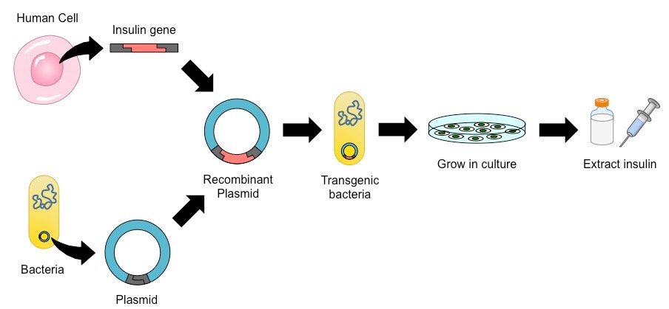
Applications of recombinant DNA in genetic engineering are:
For the production of vaccines like the hepatitis B vaccine.
Production of transgenic plants with improved qualities like insect and drought resistance and nutritional enrichment.
Therapeutic protein production like insulin.
Gene therapy in diseases like cancer etc.
Production of transgenic animals with improved quality of milk and egg.
Production of an Insulin

Slide 15
Agriculture:
Genetically modified crops
Resistance to diseases, insects and pests, herbicides, drought; metal toxicity tolerance; induction of male sterility for plant breeding purposes; and improvement of quality can be achieved through this recombinant DNA technology.
Pharmacology:
Large-scale production of human hormones and other proteins with therapeutic uses
Production of safer vaccines
Medicine:
Human Gene Therapy
Production of antibiotics, hormones, vaccines and interferon
A number of therapeutic gene products —insulin, interleukins, interferons, growth hormones, erythropoietin, and coagulation factor VIII—are now produced commercially from cloned genes
Diagnosis of genetic disorders
Forensic Evidence
“Golden rice” with beta-carotene which is required to make vitamin A, helps to prevent blindness
BT-cotton, resistant to bollworms; Herbicide or pesticide-resistant corn & soybean
Production of Antibiotics like Penicillium and Streptomyces
Production of Hormone Insulin

Slide 16
Gene cloning and applications- long
It refers production of multiple copies of a particular gene by using techniques of genetic engineering.
E.g. insulin gene cloning for long

Slide 17
Gene Therapy
Gene therapy is a technique that involves the replacement of defective genes with healthy ones in order to treat genetic disorders.
It is used in the replacement of genes that cause medical ill-health
The method generally destroys the problem causing genes
It helps the body to fight against diseases by adding genes to the human body
This method is employed to treat diseases such as cancer, cystic fibrosis, etc.
Application of Gene Therapy/ Gene cloning

Slide 18
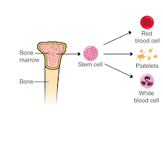
Stem Cell Biology
Stem cells are one of most fascinating areas of biology today
Bone marrow is a spongy substance found in the center of the bones.

Slide 19
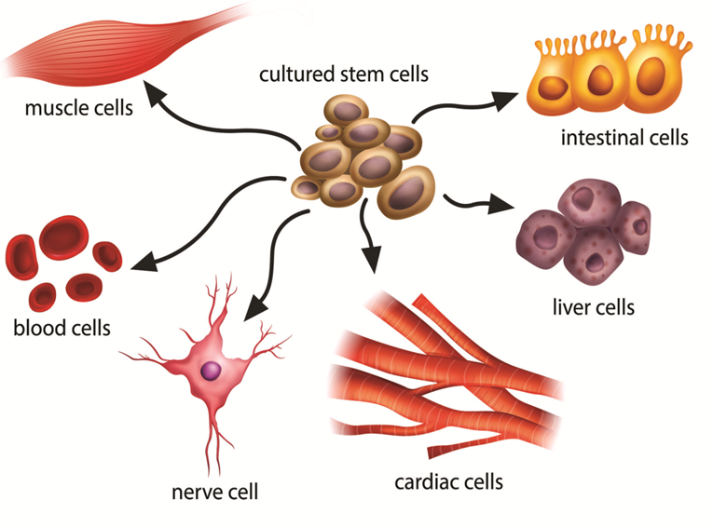
Stem Cells
They serve as a repair system for the body.
A specific type of cell capable of evolving into many different types of specialized cells within the body
Research on stem cells is going on, and it is believed that stem cell therapies can cure ailments like paralysis and Alzheimer’s as well.
Ability to continuously divide and develop into various other kinds of cells.
Stem cells offer great promise as therapy for a number of diseases.
Gibco media and supplements

Slide 20
Stem cells are different from other cells in the body in three ways:
Proliferation: They can divide and renew themselves over a long time
Differentiation: They are unspecialized, so they cannot do specific functions in the body
Plasticity: They have the potential to become specialized cells, such as muscle cells, blood cells, and brain cells

Slide 21
There are two major sources of stem cells:
Embryonic stem cells and adult stem cells are also called tissue stem cells.
Embryonic stem (ES) cells - Derived from the inner cell mass of a embryo at a very early stage of development, when it is composed of a hollow sphere of dividing cells (a blastocyst).
Adult stem cells: Some tissues in the adult body, such as the epidermis of the skin, the lining of the small intestine, and bone marrow, undergo continuous cellular turnover.
They contain stem cells, which persist indefinitely, and a much larger number of “transit amplifying cells,” which arise from the stem cells and divide a finite number of times until they become differentiated.

Slide 22
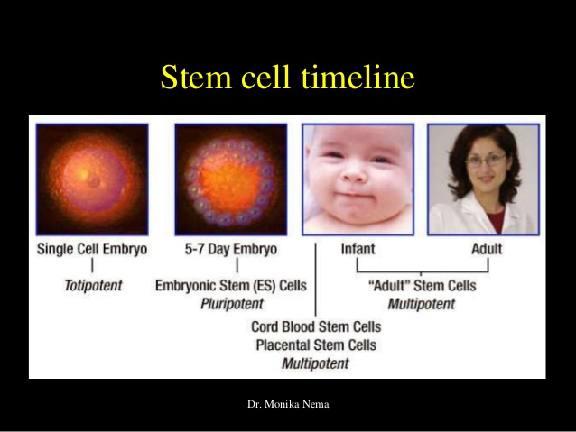

Slide 23
Types/ Forms of Stem Cells
There are 5 major types:
Pluripotent Stem Cells: These are the cells from an early embryo (blastocyst 5-14 days) and can differentiate into over 200 types of cell type.
Totipotent Stem Cells: These can differentiate into all possible types of cells.
These types of cells are found in plants and in early embryos (1-3 days)
Each cell can form a complete organism.
Multipotent Stem Cells: These differentiate into a closely related cell type.
e.g., the hematopoietic stem cells differentiate into red blood cells and white blood cells.
Unipotent Stem Cells: They can produce cells only of their own type. Since they have the ability to renew themselves, they are known as unipotent stem cells.
e.g., Muscle stem cells.
Oligopotent Stem Cells: Adult lymphoid cells are oligopotent. They can differentiate into a few different types of cells.

Slide 24
Application or uses of Stem Cell
Basic research: Clarification of complex events that occur during human development and understanding molecular basis of cancer
Biotechnology (drug discovery and development): Stem cells can provide specific cell types to test new drugs
Tissue Regeneration: This is the most important application of stem cells. The stem cells can be used to grow a specific type of tissue or organ.
This can be helpful in kidney and liver transplants.
The doctors have already used the stem cells from beneath the epidermis to develop skin tissue that can repair severe burns or other injuries by tissue grafting.

Slide 25
Application of Stem Cell
Treatment of Brain Diseases: Stem cells can also treat diseases such as Parkinson’s disease and Alzheimer’s.
Cancer treatment: They are applied especially to treat cancers, which require high-dose chemotherapy within the scope of medical care.
The patient’s own stem cells are extracted from bone marrow or peripheral blood prior to high-dose chemotherapy, stored temporarily and transplanted after the treatment in order to minimize the side effects of the aggressive chemotherapy and to support the regeneration of destroyed cells.
These can help to replenish the damaged brain cells.
Researchers have tried to differentiate embryonic stem cells into these types of cells and make it possible to treat diseases.

Slide 26
Areas of active research on stem cell biology
Treating liver disease with stem cells that have been manipulated to become specialized liver cells
Creating stem cell-derived neurons for the study of motor neuron disease
Creating insulin-producing pancreatic beta cells for clinical trials in diabetes
Stimulating an anti-brain tumor immune response via manipulated stem cells
Investigating the use of stem cells to study and treat Gaucher disease and parkinsonism
Reprogramming tumor-specific immune cells from stem cells for cancer immunotherapy
Manipulating stem cells to become bone and cartilage

Slide 27
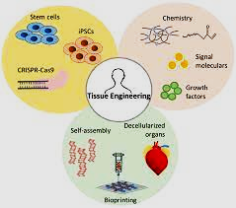
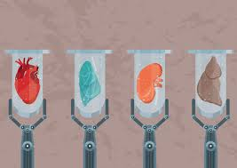
Tissue Engineering
An interdisciplinary field that applies the principles of engineering and life sciences toward the development of biological substitutes that restore, maintain, or improve tissue functions or a whole organ.
Tissue engineering utilizes living cells as engineering materials.

Slide 28
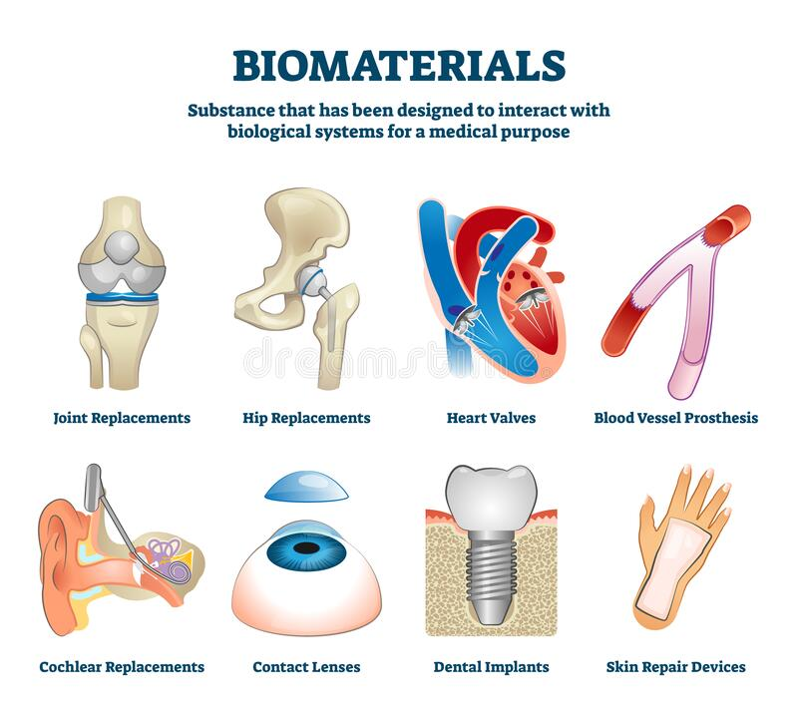
A biomaterial is a substance that has been engineered to interact with biological systems for a medical purpose, either a therapeutic or a diagnostic one.

Slide 29
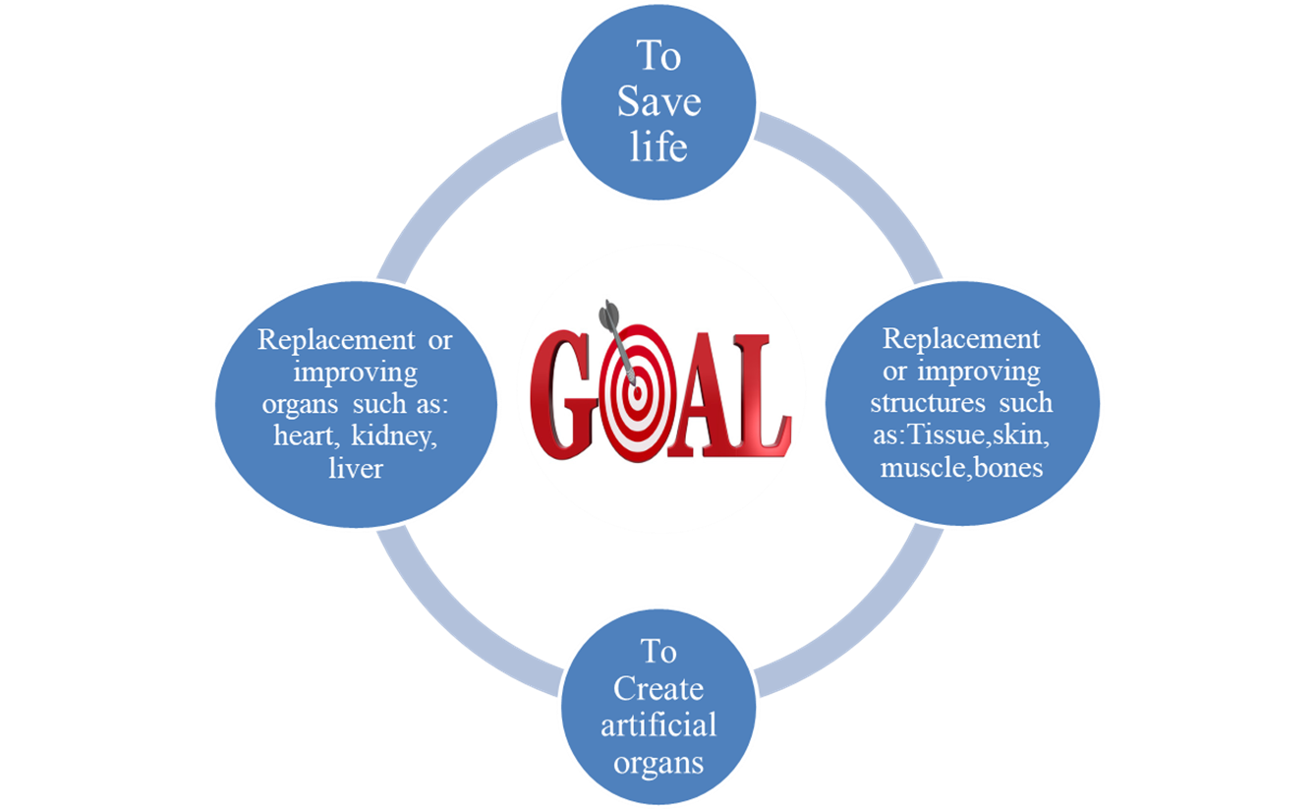
GOALS OF TISSUE ENGINEERING

Slide 30
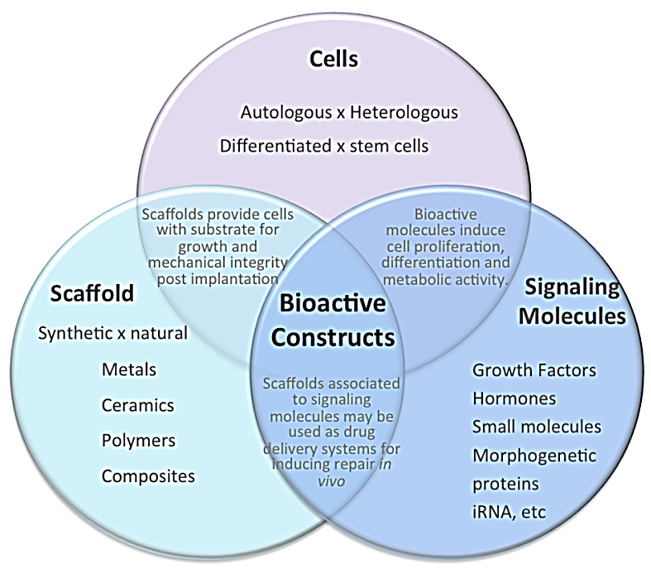
Tools of Tissue Engineering
Three tools of tissue engineering
Cell
Living part of the tissue
Produce proteins and provide functions of cell
Scaffold
Provides structural support and shape to construct
Provide place for cell attachment and growth
Usually biodegradable and biocompatible- polymers, ceramics, metals.
Cell signalling- role of signalling molecules and e.gs
Signals that tell the cell what to do
Protein and mechanical stimulation
Growth factors, cytokinin's, iRNAs, hormones etc

Slide 31
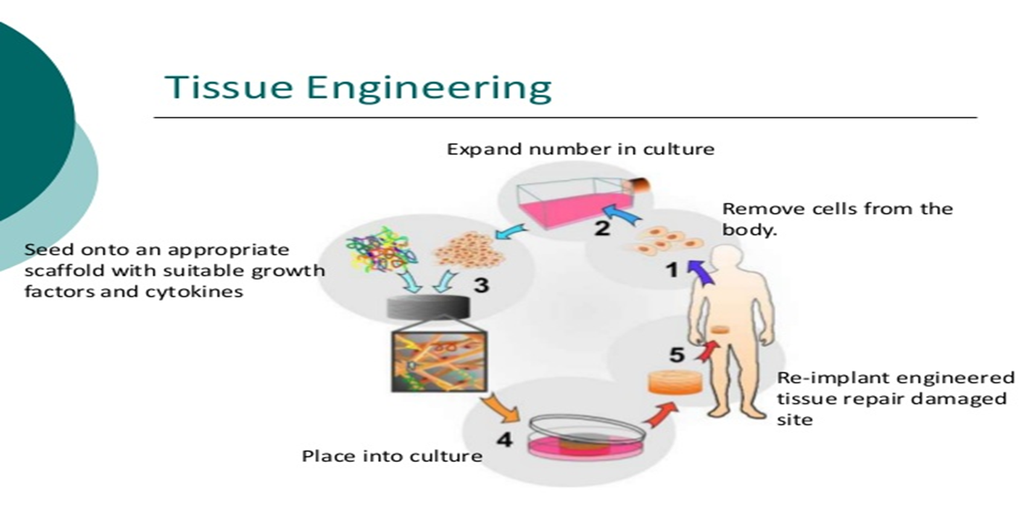
Steps/ process of Tissue Engineering- to create biological tissues
Isolated cells (taken to the culture system
Biomaterials are used for constructing scaffolds
Scaffold fabrication
Tissue culture is done either on petri dishes or bioreactors
Cultivated to selective cell differentiation time

Slide 32
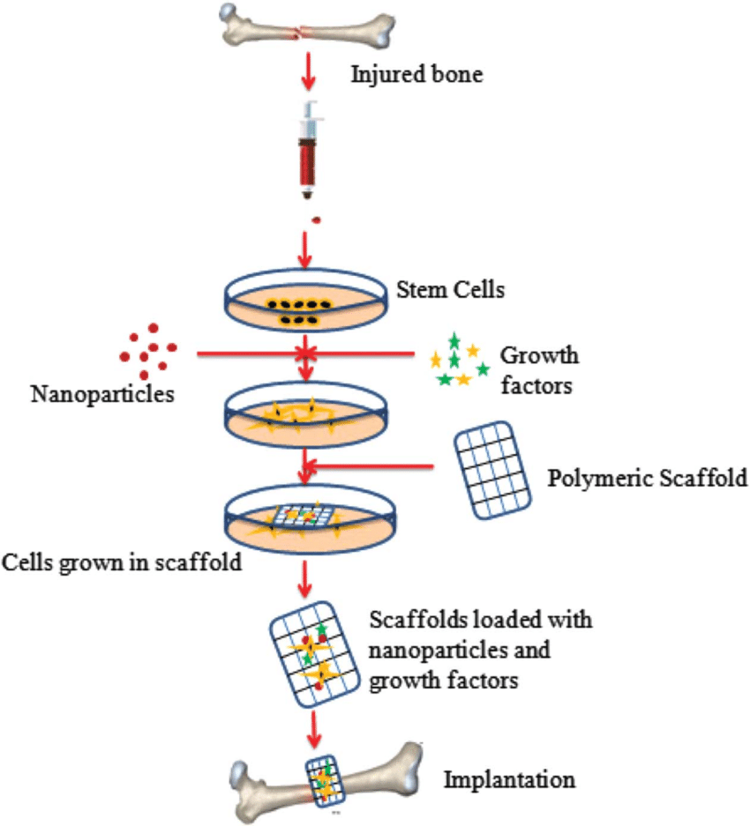
APPLICATIONS OF TISSUE ENGINEERING
Replacing the old cell: When there is damage in our body cells or organs we use tissue engineering techniques to overcome the damage by replacing the old cell.
Regenerative Medicines: Regenerative medicines repair damaged tissues and organs.
They stimulate the body’s own repair mechanisms to heal previously irreparable tissues or organs.
If the body cannot heal itself, the tissues or organs can be grown in the laboratory and then implanted.
Regenerative Medicine also involves the use of stem cells or progenitor cells obtained through directed differentiation

Slide 33
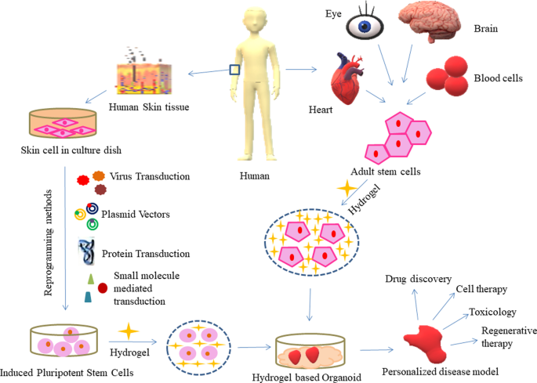
APPLICATIONS OF TISSUE ENGINEERING
Therapeutic Cloning: Bioartificial liver device, artificial pancreas, artificial bladders, and Cartilage.
There is a wide range of Tissue Engineered products or materials that are used to cure diseases in humans and save life.
Even if Tissue Engineering is life-saving, it is expensive.
Organ Transplantation: The transplantation of cells that perform a specific biochemical function (e.g. Artificial pancreas or Artificial liver).
Drug Discovery- For effective drug screening, 3D cultures are introduced to analyze the effect of drug action

Slide 34
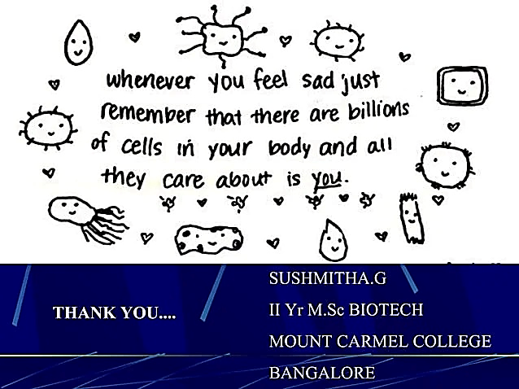

Slide 35
REFERENCES
C.B.Powar, 2010.Cell Biology.5th Ed,Himalyan Publishing House.
Sandhu, Sardul Singh. Recombinant DNA Technology. India: I.K. International Publishing House Pvt. Limited, 2013. John G. Webster 1998.
Principles of Tissue Engineering. Switzerland: Elsevier Science, 2000.
Jeremy M. Berg, John L. Tymoczko and Lubert Stryer. 2006. “Biochemistry,” 6th Ed. W.H. Freeman and Co. Ltd.
Robert Weaver. 2012 “Molecular Biology,” 5th Edition, MCGraw-Hill.
Concepts and Applications of Stem Cell Biology: A Guide for Students. Germany: Springer International Publishing, 2020.
Martin Alexander, 1994 “Biodegradation and Bioremediation,” Academic Press.

Slide 36
THANK YOU

